Slide 1
Implementing personal protective equipment
In nursing homes
To prevent the spread of
Extensively drug-resistant organisms (XDROs) & Multidrug resistant organisms (MDROs)
Introducing Enhanced Barrier Precautions
Karen Trimberger RN, MPH, NE-BC, CIC
Infection Prevention Consultant
Hektoen Institute/Illinois Department of Public Health
Notes:
Read Title of slide and add “introducing enhanced barrier precautions”
The purpose of this video is to provide LTCFs with a short educational video for EBP. Full implementation of EBP will require additional study and review of CDC, and state and local requirements. Please utilize the resources at the end of the presentation.

Slide 2


Digitallearning.eletsonline.com
Review the difference between colonization and clinical infections.
Review standard and contact precautions and introduce enhanced barrier precautions.
Describe the impact of multidrug resistant organisms in long-term care facilities.
Identify appropriate personal protective equipment (PPE) to use for each precaution based on the type of activity being performed.
Examine when room restrictions are warranted.
Notes:
Read slide

Slide 3
A review of the basics
Colonization/Infection
Standard Precautions
Personal Protective Equipment (PPE)

Slide 4
Colonization
Microorganisms (e.g., bacteria, fungi) are present on or in the body but are not causing disease.
Bacteria or fungi are present without evidence of infection.
Notes:
Read slide

Slide 5
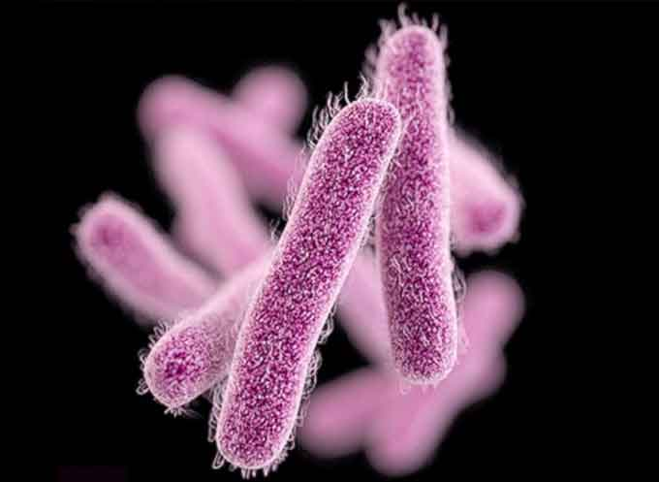
infection
Active process where microorganisms (e.g., bacteria, fungi) are causing harm to the body.
Bacteria or fungi have grown and the person is displaying symptoms from them.
Carbapenem-resistant enterobacteriaceae
Americansecuritytoday.com
Notes:
Read slide

Slide 6
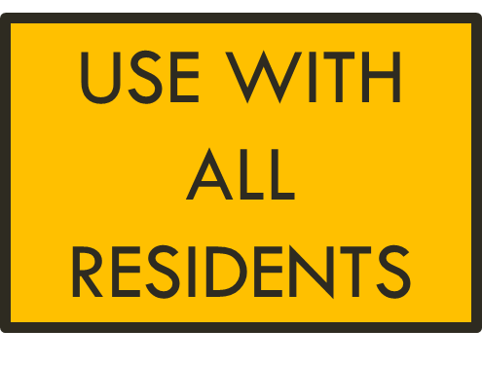
Standard Precautions
A group of infection prevention practices that apply to all patients, regardless of suspected or confirmed infection status, in any setting in which health care is delivered.
Standard Precautions are based on the principle that all blood, body fluids, secretions, and excretions (except sweat) may contain transmissible infectious agents.
          Hand hygiene
          Use of personal protective equipment (e.g., gown, gloves, masks, eyewear)
          Respiratory hygiene / cough etiquette
          Sharps safety (engineering and work practice controls)
          Safe injection practices (i.e., aseptic technique for parenteral medications)
          Sterile instruments and devices
          Clean and disinfected environmental surfaces
Notes:
Read slide but add that this presentation will focus on the use of personal protective equipment

Slide 7
Personal protective equipment (PPE)
Use of PPE is based on the staff interaction with residents and the potential for exposure to blood, body fluid, or pathogens (e.g., gloves are worn when contact with blood, body fluids, mucous membranes, non-intact skin, or potentially contaminated surfaces or equipment are anticipated).
Notes:
Remember---the use of “read slide”

Slide 8

Why Enhanced
Barrier Precautions?
Contact Precautions alone has failed to control the transmission of multidrug-resistant organisms in nursing homes.
Facilities need an approach to gown/glove use that is less restrictive than Contact Precautions and can be sustained for prolonger periods of time.
A category of TBP that balances “patient-centered care” and “risk.”
Notes:
Read slide

Slide 9
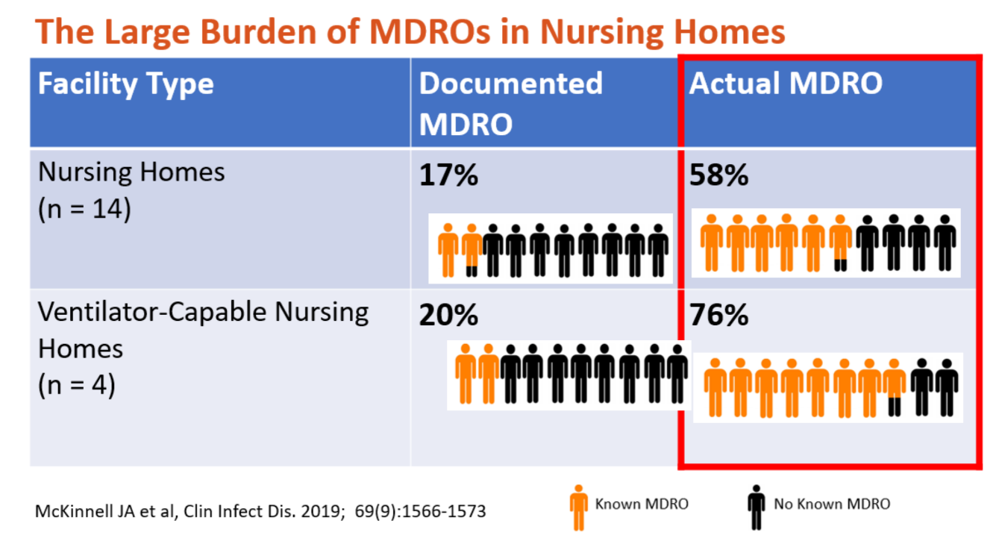


How do we know Contact Precautions alone has failed
to control the transmission of multidrug-resistant organisms in
nursing homes?
Notes:
Read slide title
A study by Mckinnell et al published in the Clinical Infectious Disease journal in 2019 highlighted the large burden of MDROs in nursing homes
When looking at 14 nursing homes---17% of the residents had documented MDROs but actually 58% of the residents were colonized or infected with an MDRO
And then when they studied ventilator capable nursing homes (4 total) 20% of residents had documented MDROs but 76% were identified to be colonized and infected with an MDRO
As you can see, the documented or known cases of MDROs are just the tip of the iceberg, it’s the UNKNOWN (or the ones we weren’t aware of that are contributing to the silent spread of MDROs in LTC

Slide 10

Why has contact precautions failed to stop the spread of MDROs?
Many nursing homes residents are unknowingly colonized with an MDRO, especially those residents with risks factors like wounds and indwelling medical devices.
Residents with MDRO remain colonized for long periods of time and can spread MDROs to others.
Unfortunately, MDROs are spread by health care personnel (HCP) through contaminated hands and clothing.
Not all HCP follow procedures appropriately for TBP and consequently they are transferring the MDROs from one resident to another resident.
Notes:
Read

Slide 11
Risk
Person Centered Care
EBP Balances person-centered care
& Risk?
Courtesy of
Deb Burdsall
Patient-centered
Residents’ need to socialize and to participate in communal dining, group activities.
Isolation is scary and can be stigmatizing if required to stay in their room and not come out unless medically necessary.
Residents on Enhanced Barrier Precautions are not restricted to their rooms and may leave their room to participate in communal dining and group activities.
Risk
Does the resident have an indwelling medical device, open wounds, or are they immuno-compromised?
EBP helps protect residents at risk for acquiring colonization (those with wounds, indwelling devices, etc.).
Notes:
The Centers for Disease Control and Prevention or CDC introduced a new category of TBP in an attempt to balance person centered care and risks

Slide 12
Transmission-based precautions
Transmission-based Precautions
Airborne
Enhanced Barrier
Droplet
Contact
Explaining the Difference between Contact Precautions and Enhanced Barrier Precautions
Notes:
Explaining the difference between contact precautions and enhanced barrier precautions

Slide 13
Transmission-based precautions
Transmission-Based Precautions (TBP) are for residents who are known or suspected to be infected or colonized with infectious agents, including certain epidemiologically important pathogens, which require additional control measures to effectively prevent transmission.
TBP are intended to prevent transmission of infectious agents, including epidemiologically important microorganisms, which are spread by direct or indirect contact with the patient or the patient’s environment.
https://www.cdc.gov/infectioncontrol/pdf/guidelines/isolation-guidelines-H.pdf
Notes:
First let’s define transmission based precautions---read

Slide 14
Enhanced barrier precautions (EBP)
Transmission-based Precautions
Airborne
Enhanced Barrier
Droplet
Contact
What are EBP?
Notes:
What are EBPs

Slide 15
What are enhanced barrier precautions (EBP)?
EBP expands the use of PPE beyond situations in which exposure to blood and body fluids is anticipated.
EBP falls between standard precautions and contact precautions on the continuum of care.
EBP requires the use of gown and gloves when performing high-contact resident care activities.
Gown and gloves are not required when NOT performing a high contact activity.
EBP offers better protection for the resident (prevention of colonization or infection).
Intended to be used during the resident’s entire stay (or until wound heals or medical device is removed).
Standard
Precautions
Enhanced Barrier
Precautions
Contact
Precautions
Notes:
Read slide

Slide 16
What are High-contact resident care activities
Dressing
Bathing or showering
Transferring
Providing hygiene
Changing linens
Changing briefs or assisting with toileting
Device care or use (urinary catheters, feeding tubes, tracheostomy/ventilator, central lines)
Wound care (requiring a dressing)

Slide 17
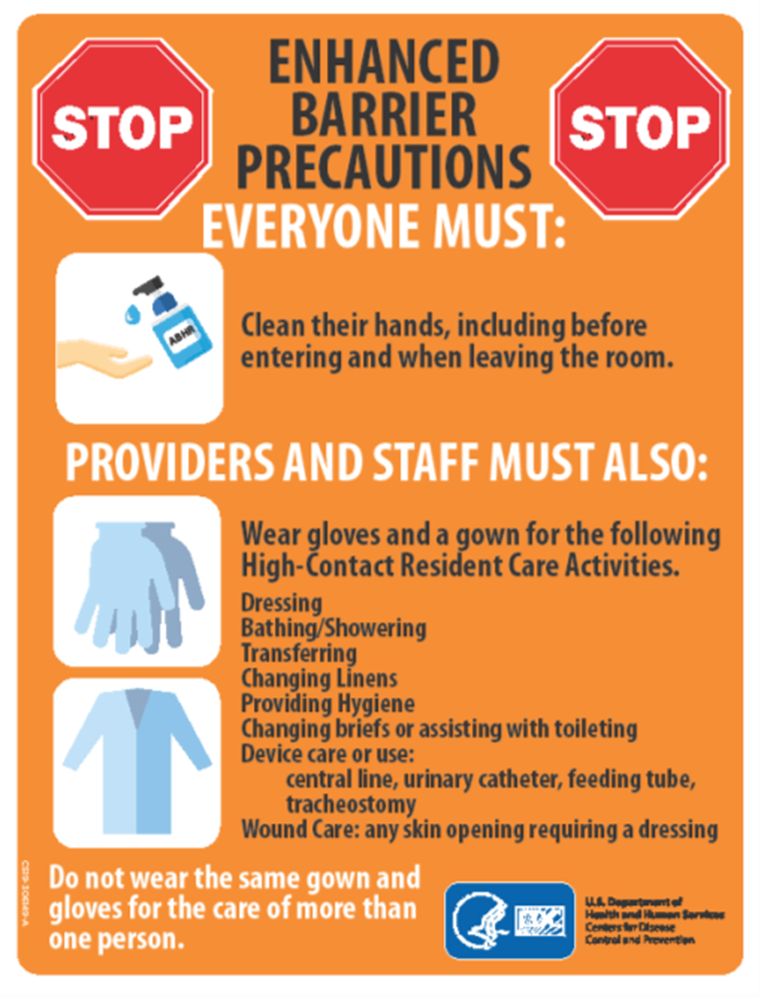
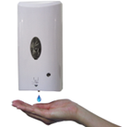
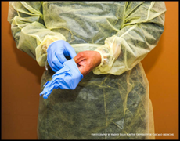
Enhanced barrier precautions-- what’s required?
INTENDED TO BE USED FOR THE
RESIDENT’S ENTIRE LENGTH OF STAY or UNTIL THE WOUND HAS HEALED OR THE DEVICE IS REMOVED
Enhanced Barrier Precautions (EBP)
Signage | Post on doorframe and above bed if resides in multi-occupancy room
Hand hygiene | Hand hygiene EVERY TIME
Personal Protective Equipment | Gown and gloves EVERY TIME with high-contact activities
Communal Dining and Group Activities | May Participate
Private or Single room | Not required
We are trying to prevent the transfer of organisms to staff hands and clothing.
Notes:
Requirements for EBP

Slide 18
Contact precautions (CP)
Transmission-based Precautions
Airborne
Enhanced Barrier
Droplet
Contact
What are CP?

Slide 19

“old”Contact precautions vs. “new” contact Precautions
Gracetruthwindsor.com
Notes:
Introducing EBP in LTCFs will cause all staff to revisit how they have implemented Contact precautions. This is a true Paradigm shift for many LTCFs. What do I mean by that?

Slide 20

The “old” contact precautions
Contact Precautions in long-term care facilities often allowed residents to come out of their rooms and participate in communal dining and group activities if the wound or drainage could be contained.
Creazilla.com

Slide 21
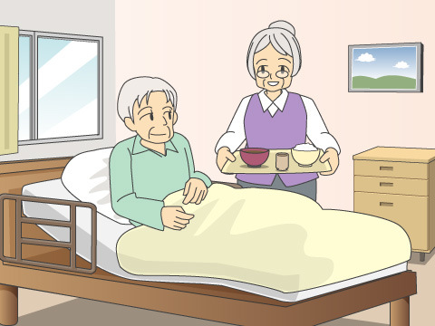
The “new” contact precautions
Residents will be required to stay in their rooms unless medically necessary to come out. The resident should not participate in communal dining and group activities.
Homemate-.com

Slide 22
Contact Precautions should be used:
All residents with draining wounds that cannot be contained (e.g., who cannot maintain adequate hygiene) and/or diarrhea, regardless of MDRO status.
On units or in facilities where ongoing transmission is documented or suspected.
For infections (e.g., C. difficile, norovirus, scabies) and other conditions where Contact Precautions is recommended by the CDC.

Slide 23
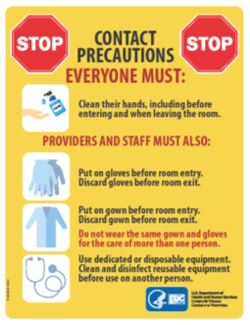


Contact precautions--What’s required?
Contact Precautions (CP)
Signage | Post on doorframe Each bed treated as private room in multi-occupancy rooms
Hand hygiene | Hand hygiene EVERY TIME
Personal Protective Equipment | Gown and gloves EVERY TIME
Equipment | Dedicated or disposable Reusable-clean and disinfect
Communal dining and group activities | Not allowed. Dining and activities should occur in resident’s room only.
Private or single room | Preferred. May cohort like organisms. Follow Cohorting Guidance and consult with local health department.
Notes:
Contact Precautions are one type of Transmission-Based Precaution that are used when pathogen transmission is not completely interrupted by Standard Precautions alone.
Intended to prevent transmission of infectious agents, like MDROs, that are spread by direct or indirect contact with the resident or the resident’s environment
Require the use of gown and gloves on every entry into a resident’s room
Require dedicated equipment (e.g., stethoscope and blood pressure cuff)
Require a private room (if not available residents may be cohorted)
Residents are restricted to their rooms except for medically necessary care and restricted from participation in group activities
Intended to be time limited and, when implemented, should include a plan for discontinuation or de-escalation

Slide 24
Determining what TYPE OF Transmission-based precautionS to use
Transmission-based Precautions
Airborne
Enhanced Barrier
Droplet
Contact
Should I use EBP or Contact Precautions???

Slide 25
Cdc Recommendations for EBP
STATEMENT from the CDC Implementation of Personal Protective Equipment (PPE) Use in Nursing Homes to Prevent Spread of Multidrug-resistant Organisms (MDROs) guidance that needs to be emphasized:
“MDROs for which the use of EBP applies are based on local epidemiology. At a minimum, they should include resistant organisms targeted by CDC but can also include other epidemiologically important MDROs.”
https://www.cdc.gov/hai/containment/PPE-Nursing-Homes.html

Slide 26

Determining the type of precautions to use
When determining which type of Transmission-Based Precautions to use among residents in long-term care facilities, facilities should consider using one or more of the following approaches, keeping in mind that Standard Precautions should be used on all residents during all care:
  PATHOGEN-BASED APPROACH
  RISK-BASED APPROACH
Clipartcraft.com

Slide 27
Pathogen-based Approach
Pathogen-based:
a) XDROs: EBP may be used for residents with an XDRO unless the resident has draining wounds that can't be contained (e.g., residents who cannot maintain adequate hygiene) and/or diarrhea, in which case Contact Precautions would be indicated.
b) MDROs: A facility should use a risk-based approach to determine what type of precautions (Contact or EBP), if any, are warranted for a resident colonized or infected with MDROs. A risk-based approach takes into consideration the resident’s clinical situation, and the prevalence or incidence of MDROs in the facility. Consider this approach for residents with organisms not previously encountered in the facility.

Slide 28
Risk-based approach
Risk-based:
a) Use EBP for residents with wounds requiring dressings (e.g., pressure ulcers, diabetic foot ulcers, unhealed surgical wounds, and chronic venous stasis ulcers) UNLESS the drainage from the wound cannot be contained (e.g., residents who cannot maintain adequate hygiene), or the resident is colonized or infected with an infection or condition listed in CDC’s Guideline for Isolation Precautions Appendix A where Contact Precautions are recommended.
b) Use EBP for residents with any indwelling devices (e.g., central lines, urinary catheters, feeding tubes, hemodialysis catheters, tracheostomies, and ventilators) UNLESS the resident is colonized or infected with an infection or condition listed in CDC’s Appendix A where Contact Precautions are recommended.

Slide 29
Wounds requiring a dressing
What type of wounds are we talking about?
CDC does not typically include a skin break/tear that would be covered by a band-aid or another type of dressing similar to a band-aid as a wound requiring a dressing.
CDC consider the following as “wounds requiring a dressing”
          pressure ulcers
          diabetic foot ulcers
          unhealed surgical wounds
          other wounds, such as chronic venous stasis ulcers.
These are surgical wounds that aren’t healing…NOT a fresh post-op surgical wound for total joints, etc.

Slide 30
Indwelling medical devices
What type of medical devices are we talking about?
CDC defines indwelling medical devices as those that communicate to the outside.
CDC would not classify a dialysis fistula as an indwelling medical device if it has healed, but it does include hemodialysis catheters that have direct access to the outside.
CDC considers the following as “indwelling medical devices”
        central lines
        urinary catheters
        feeding tubes
        hemodialysis catheters
        tracheostomies
        ventilators
An ostomy or stoma (fresh or mature) are NOT an indication for EBP.

Slide 31

How to implement EBP
Provide EBP education and training to staff.
Validate competency of staff on PPE use for EBP.
Start Slow! (e.g., start with one unit and ensure everyone understands the principles of EBP before moving to the next unit).
Select a unit that has a higher burden of XDROs or MDROs or a unit where ventilators or trach residents reside.
Consider using the CDC Pre-implementation tool for EBP to assess readiness.
Redbubble.com

Slide 32
RESOURCES
Pre-Implementation Tool—Enhanced Barrier Precautions (EBP)
https://www.cdc.gov/hai/pdfs/containment/Pre-Implementation-Tool-for-Enhanced-Barrier-Precautions-508.pdf
Implementation Guide
https://www.cdc.gov/hai/containment/PPE-Nursing-Homes.html
FAQS
https://www.cdc.gov/hai/containment/faqs.html
PowerPoint Presentation by CDC
https://view.officeapps.live.com/op/view.aspx?src=https%3A%2F%2Fwww.cdc.gov%2Fhai%2Fpdfs%2Fcontainment%2FEBP-Presentation-July2022.pptx&wdOrigin=BROWSELINK
Letter to share with residents and families
https://www.cdc.gov/hai/pdfs/containment/Letter-Nursing-Home-Residents-Families-Friends-508.pdf
Letter to share with staff
https://www.cdc.gov/hai/pdfs/containment/Letter-Nursing-Home-Staff-508.pdf
YouTube Video from CDC on Implementation of Enhanced Barrier Precautions https://www.youtube.com/watch?v=WD87c4PP6pE&list=PLvrp9iOILTQayOi5lgk08QDgv3GHROtCf&index=23
Enhanced Barrier Precautions (EBP) Implementation—Observations Tool
https://www.cdc.gov/hai/pdfs/containment/Observations-Tool-for-Enhanced-Barrier-Precautions-Implementation-508.pdf

Slide 33

Illinois Department of public health
QUESTIONS?
Contact your local
health department or
regional IDPH
infection preventionist
Stock.adode.com

